Slide 2
objectives
Compare the strengths and limitations of three segmentation techniques.
Explore how these segmentation techniques have practical applications.
result 1
result 2
Physics-301/Activity 1 - Color Segmentation.ipynb at main · reneprincipejr/Physics-301 (github.com)
https://drive.google.com/file/d/10yAmcNsyWs8dfkm6fHbPrnsFiF5YHBX9/view?usp=sharing

Slide 3
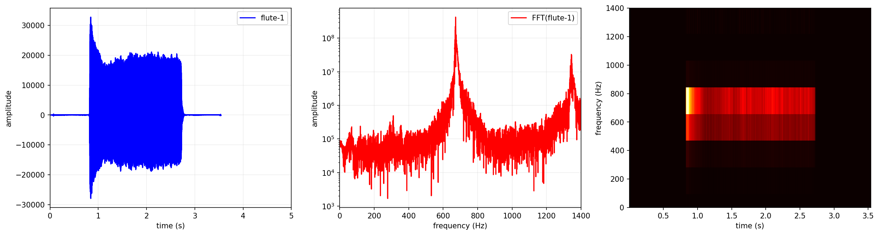
Background

Slide 4
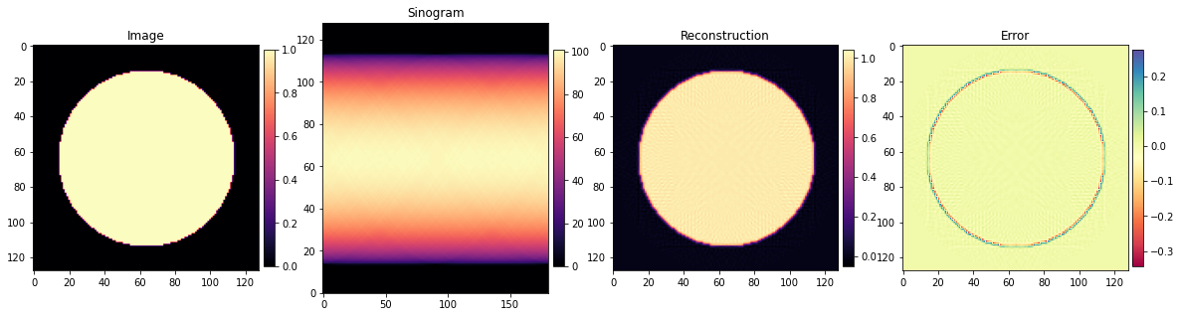
Overview
In this activity, we demonstrate the radon transform and its sinogram behaviour for synthetic shapes with increasing complexity. Transformation in the Radon domain facilitates visualization of structures within the image.
Then, we visualize the reconstruction error after the inverse radon transform is implemented. Lastly, we carried 3D visualization from successive MRI image slices, demonstrating an application in computed tomography (CT).
Notes:
such as computed tomography (CT), where it enables the reconstruction of images from a series of X-ray projections taken from different angles around an object.

Slide 5
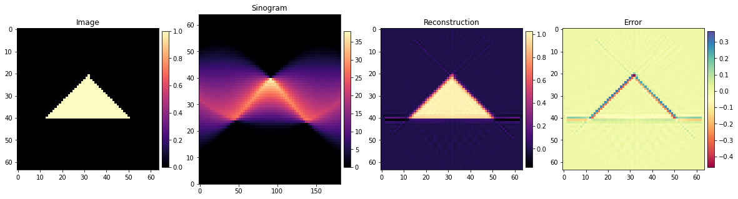
Radon Transform: Basic Shapes

Slide 6
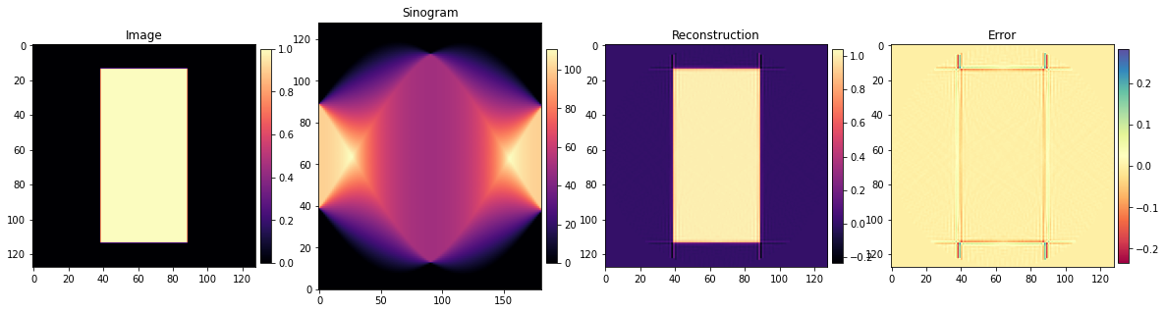
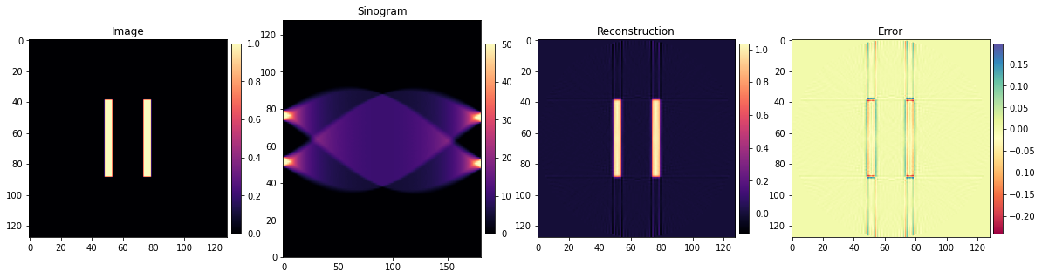
Radon Transform: Basic Shapes

Slide 7
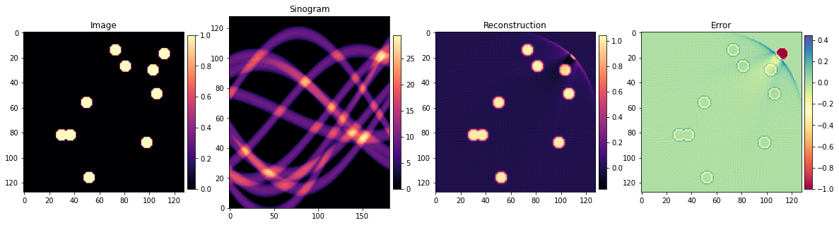
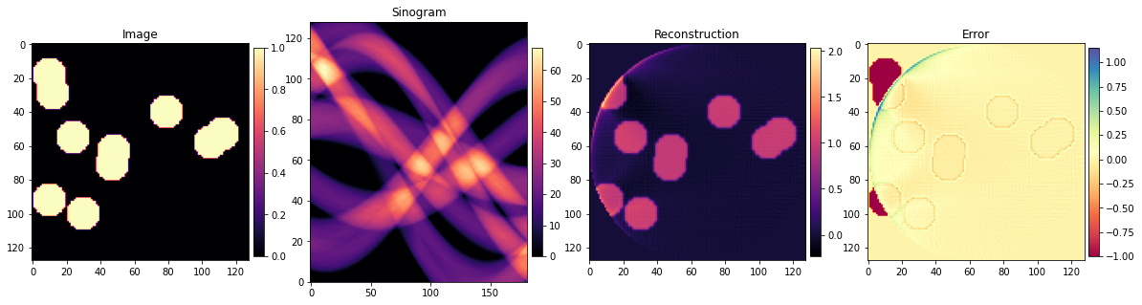
Radon Transform: Many Circles

Slide 8
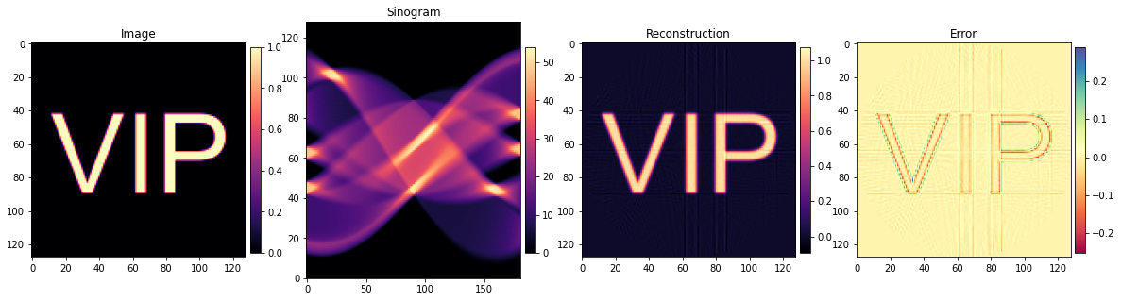
Discussion
As shown by the results, the x-axis of the sinogram represents the angles at which a line integral is obtained (0 to 180º), while the y-axis represents the spatial extent (128 pixels).
Radon transform’s polar projection acquisition is evident on a circular aperture, where its sinogram has regular density. This means it returned equal line integral across all projection angles. Interestingly, the double slit’s information is preserved on a sinogram when a projection is done horizontally (at 0º and 180º), where density is lowest upon projection across the slit’s width rather than along vertical length.
Notes:
A sinogram is a visual representation of the Radon transform of an image or object. It provides information about the line integrals obtained from different angles during the Radon transform process. Each column in the sinogram represents a specific angle, while the rows represent the distance traveled by the line integral.
The sinogram is important because it encodes valuable information about the distribution of linear features and structures within the original image or object. It captures the pattern of attenuation or absorption of the underlying material along different angles. In medical imaging, for example, a sinogram obtained from X-ray projections can be used to diagnose and analyze the internal structures of the human body. By performing the inverse Radon transform on the sinogram, the original image can be reconstructed, enabling medical professionals to visualize and examine the anatomical features and abnormalities in detail. Additionally, the sinogram can be used for tasks such as image registration, motion correction, and image quality assessment in various imaging modalities, including computed tomography (CT) and positron emission tomography (PET).

Slide 9
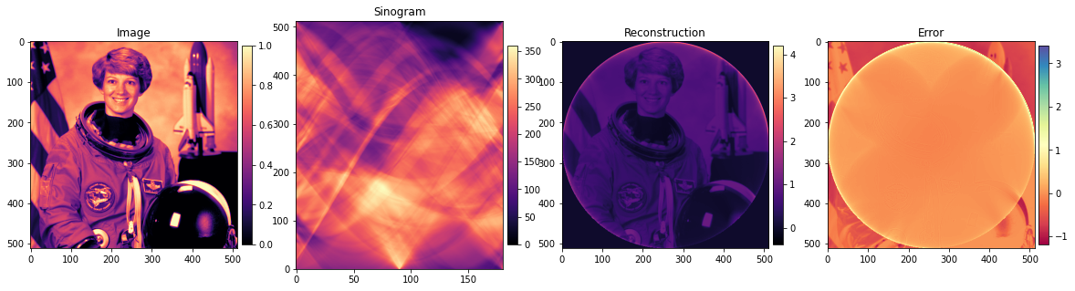
Discussion
Interestingly, a circular artifact in the recovery was observed on the radon transforms of many circles and on the sample image as shown below. Information beyond this diameter were lost upon reconstruction. This corresponds to the polar nature acquisition of radon transform.
Overall, sinogram represents the radon transform on an image and it shows the embedded features within the object in the form of density. This is widely used in medicine applications, where X-rays are projected from all directions to create sinograms, representing the internal anatomical structures of the human bod.

Slide 10
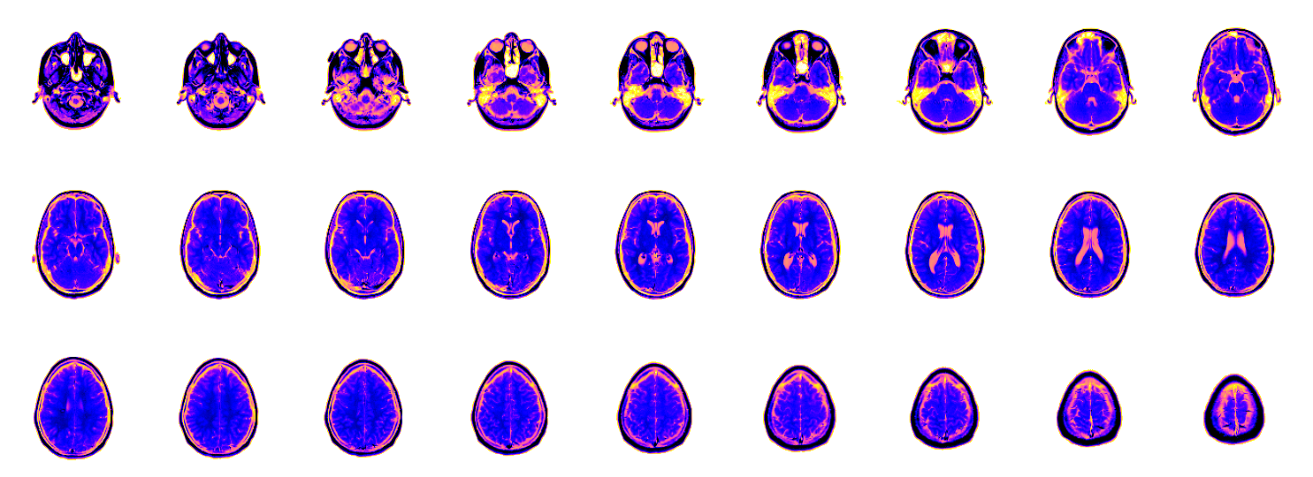
MRI Images
Through sinograms, structures like cross-sectional of the brain are imaged. Shown below are the the sample MRI images recovered using a CT device at successive heights. In this part, we will attempt to visualize these MRI images in 3D.

Slide 11
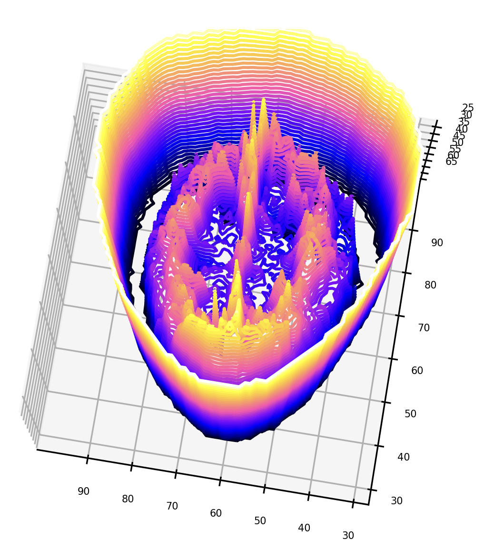
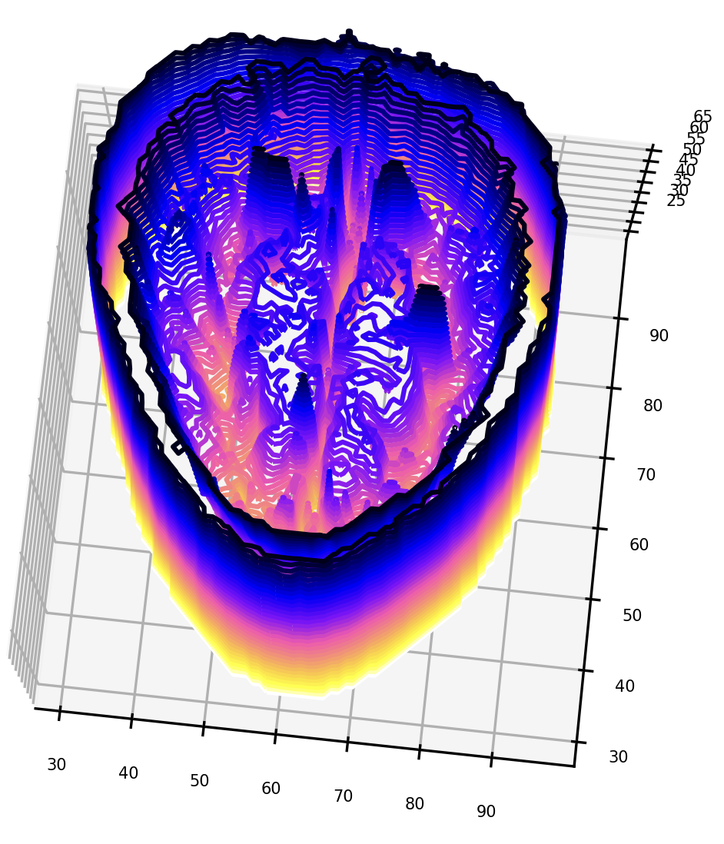
3D Contours

Slide 12
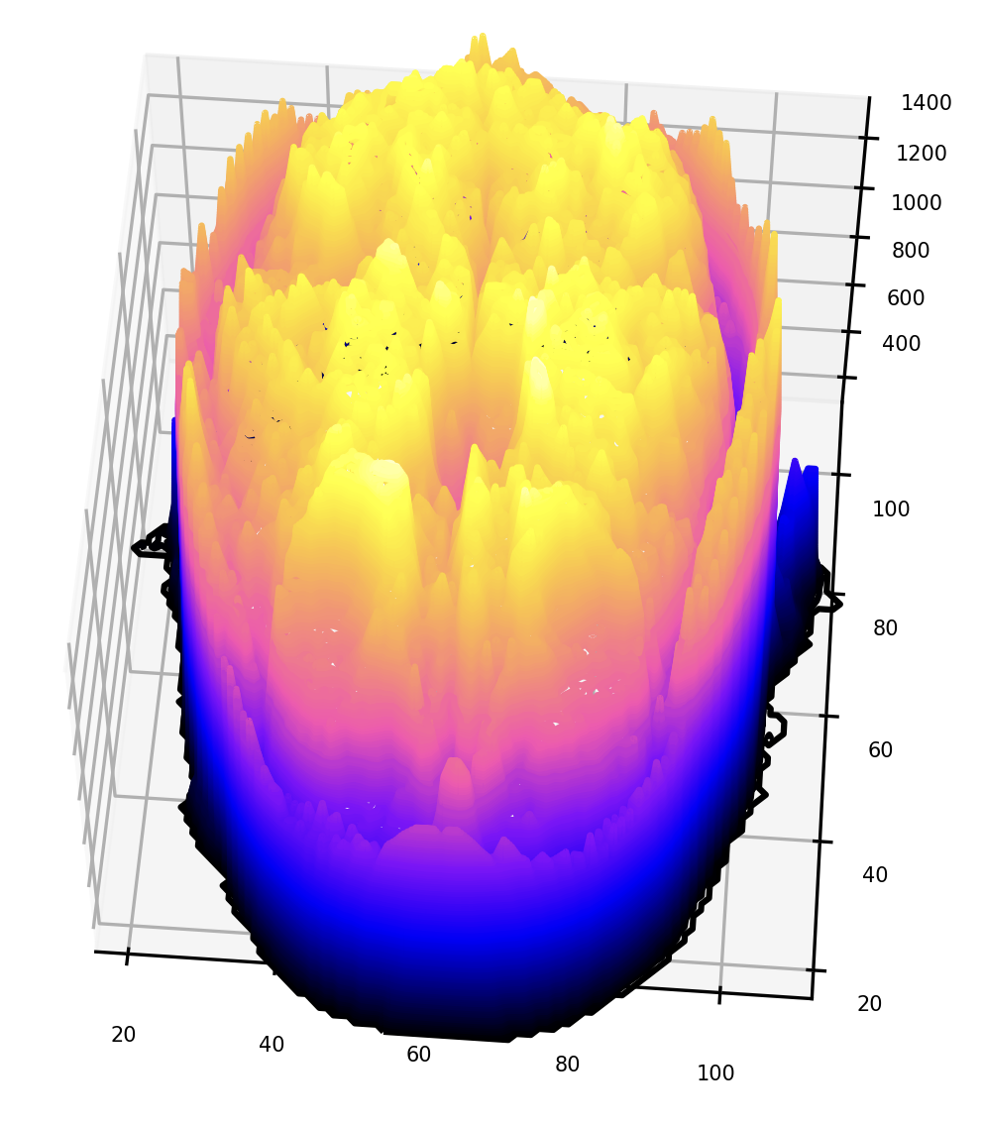
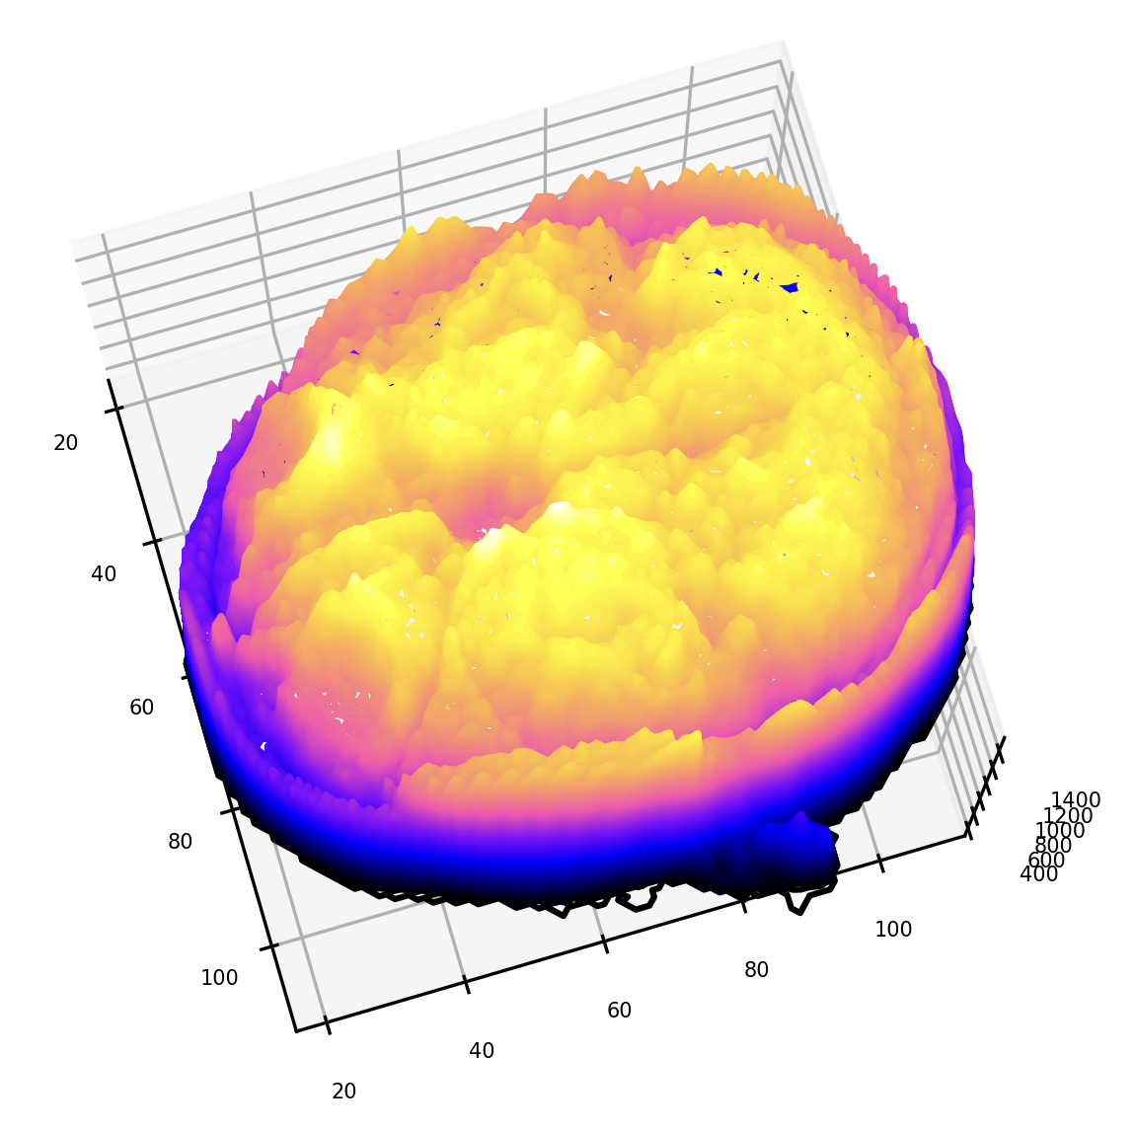
Stacking

Slide 13
reflection
This activity and the last made me appreciate the elegant power of Fourier transforms. Convolution and correlation concepts using FFT were used and in the end, I demonstrated how spatial super-resolution can be achieved by exploiting the frequency space alone. I have elaborated the parameter effects in the generated FFT correlation maps, applied thresholding and centroid detection techniques, with the end goal of localizing the peaks and super-resolving the image. I counterchecked these results to my classmate’s implementation of individual and multivariate gaussian expectation maximization.
With that said, I’d give myself a score of 105/100.
[1] M. Soriano, Physics 305 – The Radon Transform, (2023).
[2] M. Soriano, Physics 305 – Volume Visualization, (2023).

